Slide 1
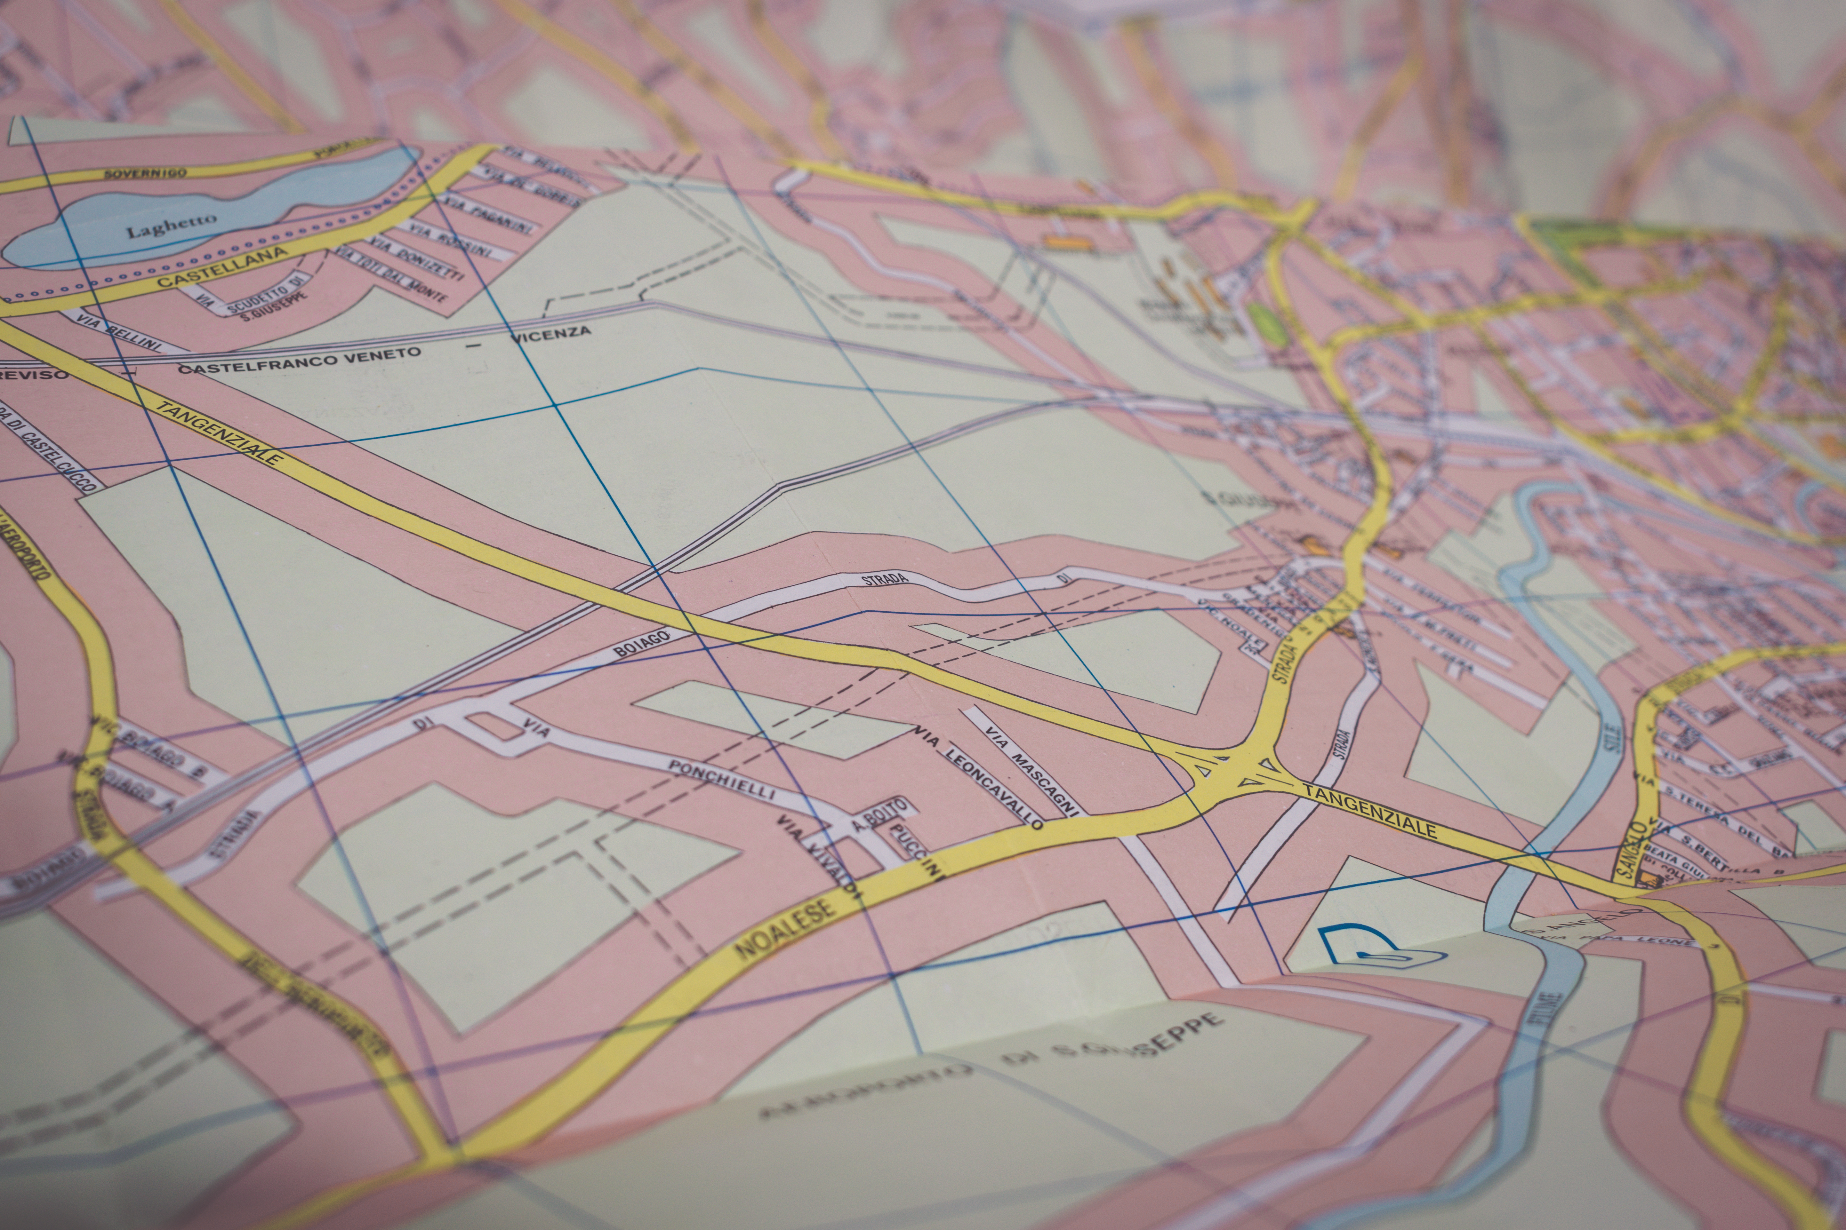

Bar-Pop
Mobile Application for Bar Populations
Created By:
Evan Bonsignori
Kyle Bergeron
Ayman Bagagas
Keyur Patel
Eid Alshareef

Slide 2
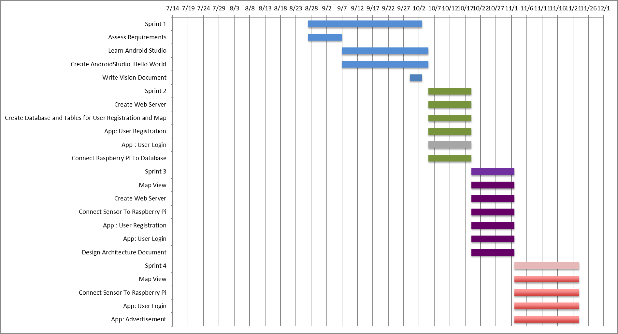

Slide 3
Functional Requirements

Slide 4
Traceability Table
 | UC1 | UC2 | UC3 | UC4 | UC5 | UC6 | UC7 | UC8 | UC9 | UC10
REQ1 | X | X
REQ2 |  |  | X |  | X
REQ3 | X |  |  |  |  |  |  | X
REQ4 |  |  |  | X
REQ5 |  |  |  |  |  | X | X
REQ6 |  |  |  |  |  | X
REQ7 |  |  |  |  |  |  |  |  | X
REQ8 |  | X |  |  |  | X | X | X | X | X
REQ9 |  |  |  |  |  |  |  |  |  | X

Slide 5
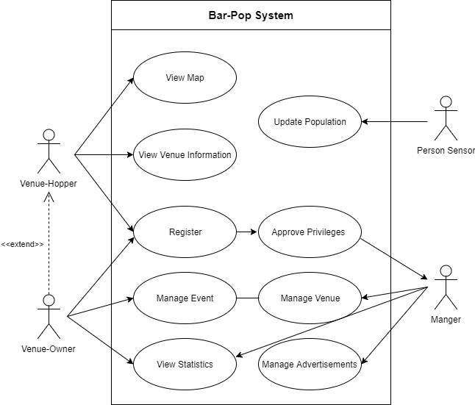
Updated Use Case Diagram

Slide 6
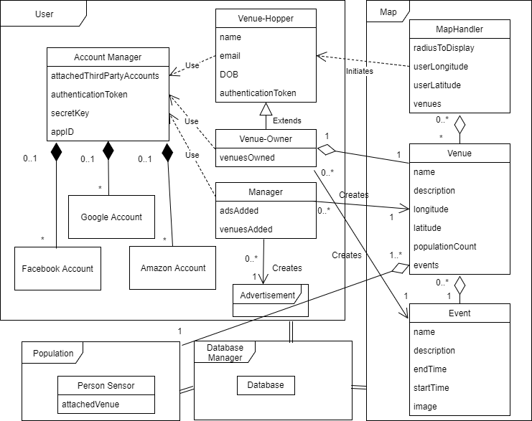
System Domain Model

Slide 7
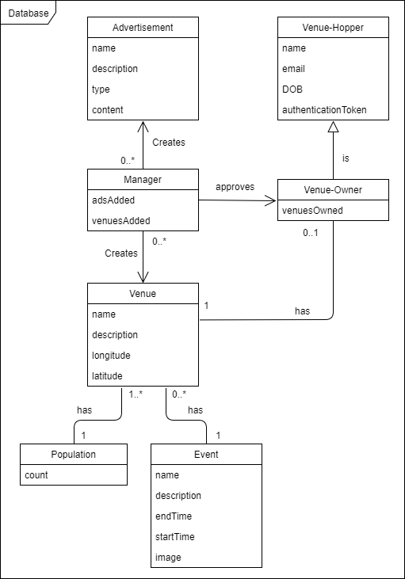
Database Model

Slide 8
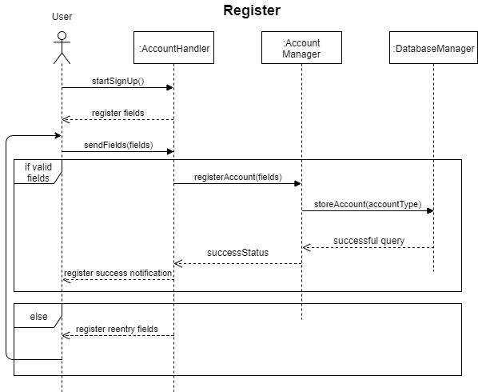

Slide 9
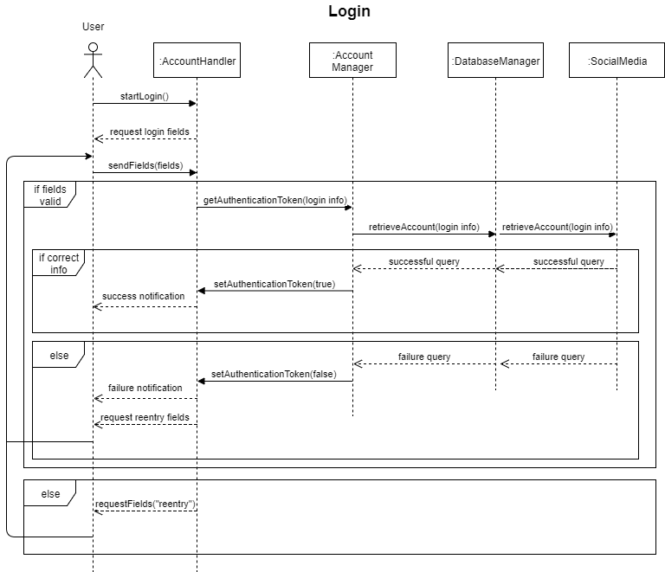

Slide 10
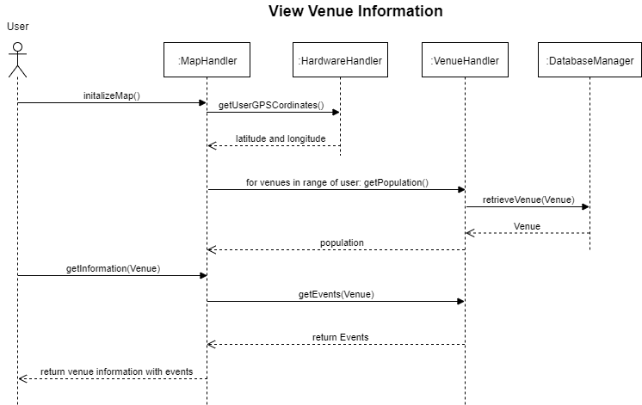

Slide 11
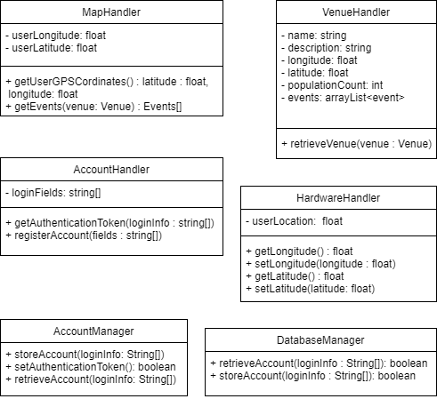
Class Diagram Excerpts

Slide 12
Demo

Slide 13
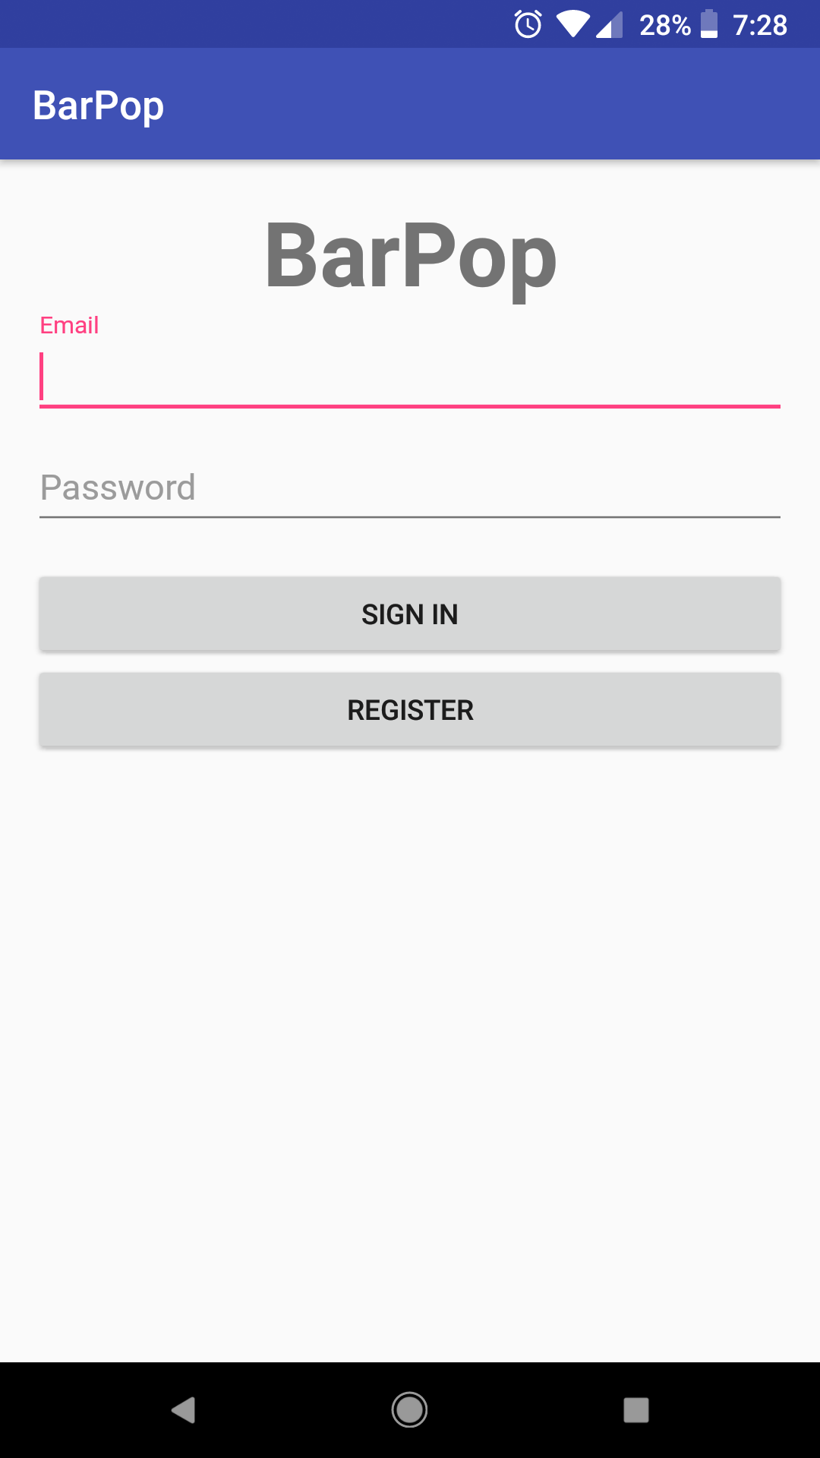
Login

Slide 14
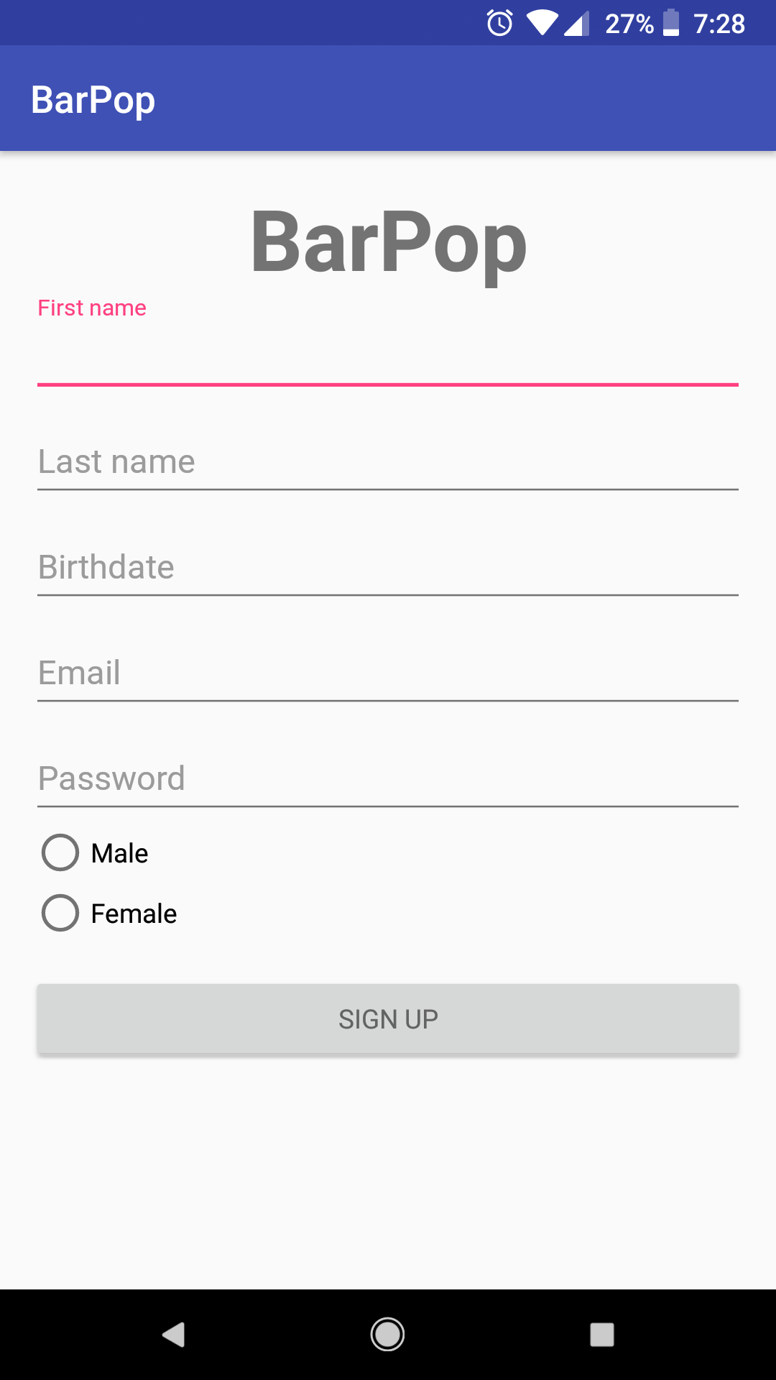
Register

Slide 15
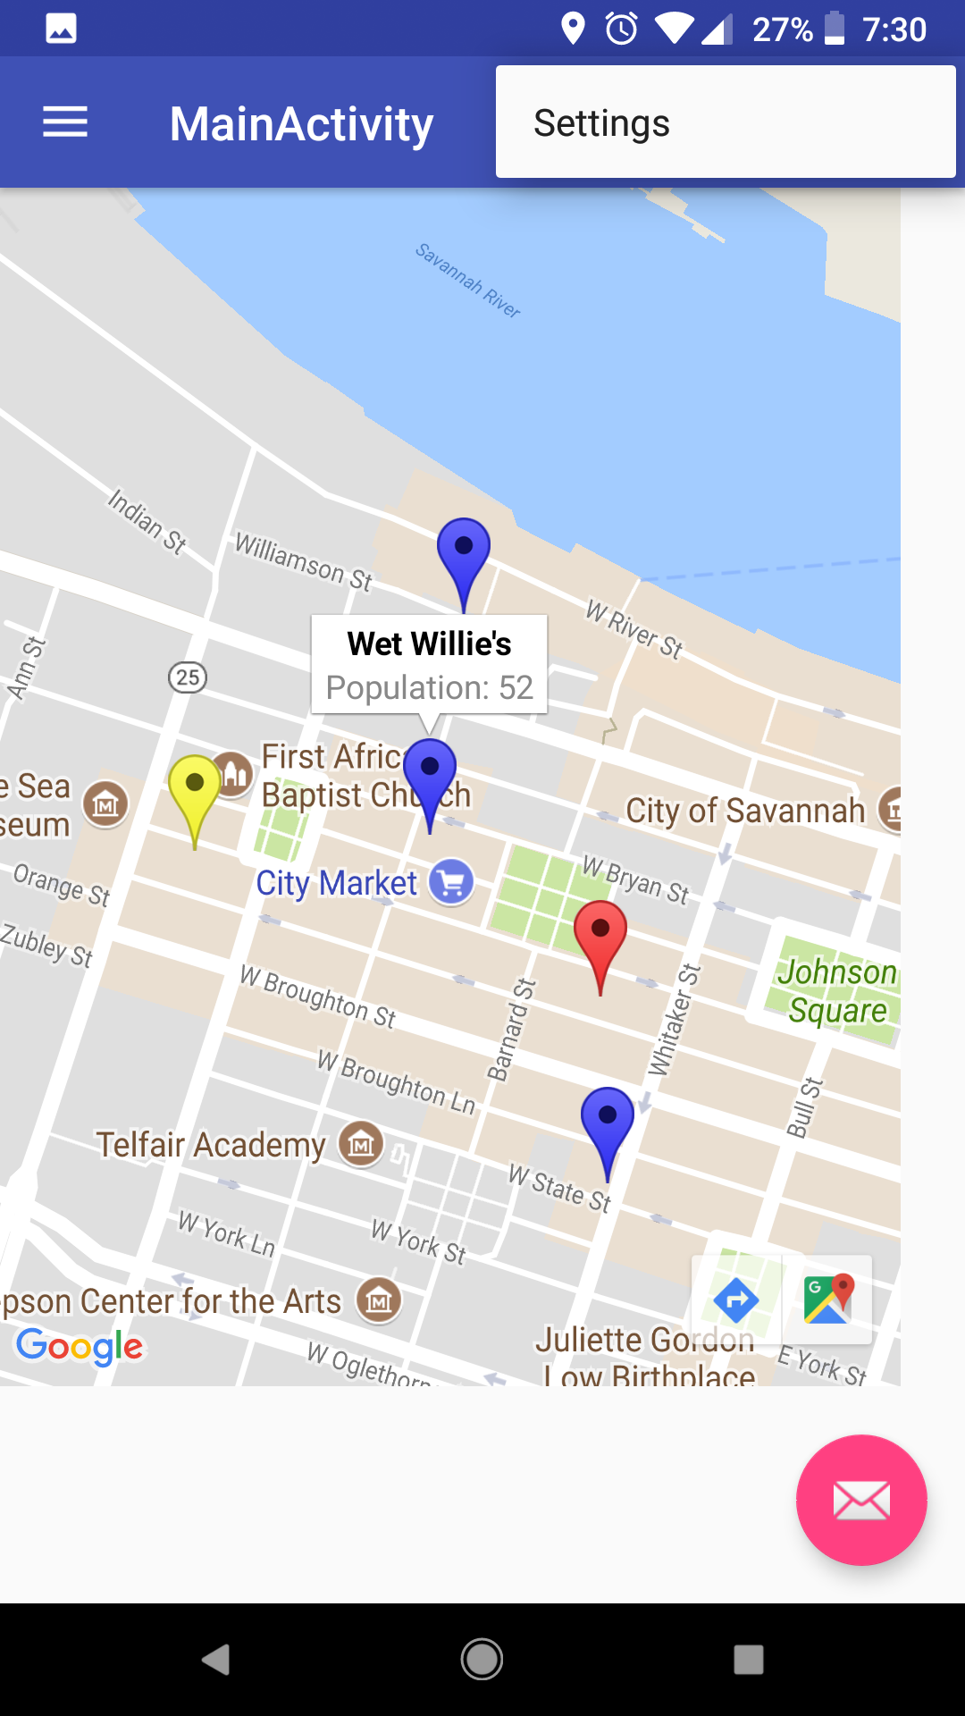
Explore

